Slide 1
Chapter 3 Delta Method
GangWoo Kim
July 14, 2021

Slide 2


Slide 3


Slide 5
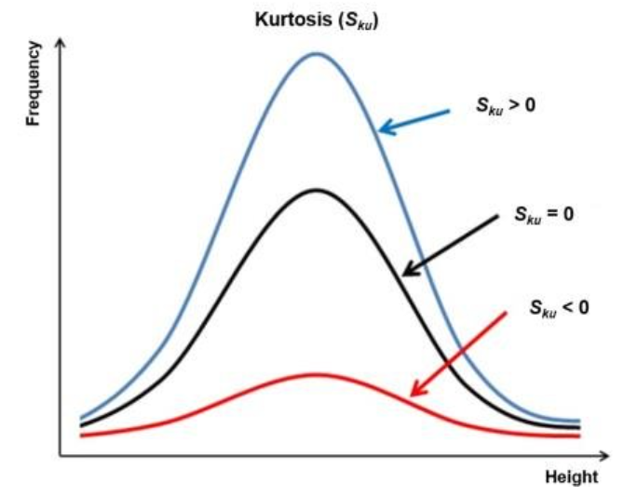

Slide 6
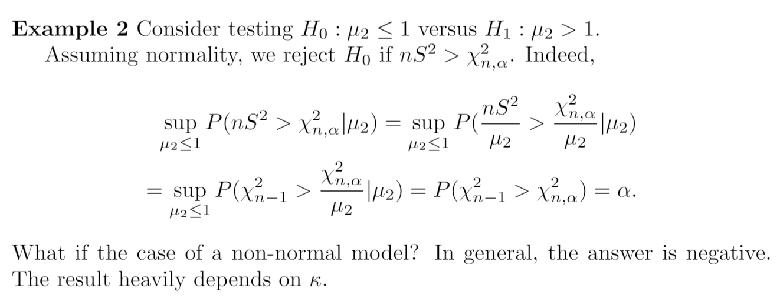

Slide 7


Slide 8
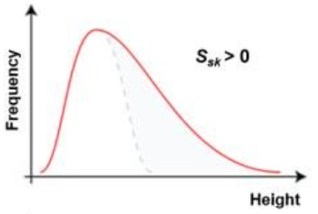
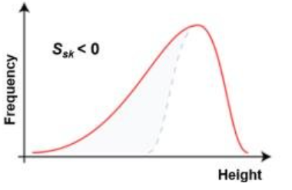


Slide 9


Slide 10


Slide 11


Slide 12


